Slide 1
NZ Airbnb: How to be Superhost & Market Dynamics
Report — comparative analysis of host behavior, reputation, and supply structure
Coverage: 47k listings (Superhost ≈22k; Non Superhost ≈24k)
Cut-off: 09.23 .2025(some 2025 metrics are partial-year)
Notes:
[Sources]
- Internal notebook: NZ_Airbnb usecase Analysis 10.0.ipynb
[/Sources]

Slide 2
Agenda
How this report answers: “How to become a Superhost & what has changed in the market?”
Data & Methodology: metric definitions, cleaning and statistical tests
Branch A (Host ↔ Features): key differences between Superhost vs Non-Superhost
Branch B (Market ↔ Features): 2017–2025 expansion, entry/exit and structural stability
Action Plan: practical levers for new hosts & platform operations
Internal analysis (NZ Airbnb usecase)
Notes:
[Sources]
- Internal notebook: NZ_Airbnb usecase Analysis 10.0.ipynb
[/Sources]

Slide 3
Executive Summary
Top takeaways
Superhost advantage is more consistent, more trusted, more reliable delivery, but not more expensive.
Strong threshold effects: near-perfect response rate and faster response time are almost mandatory to be a superhost.
Operable rating gaps:check in Cleanliness / Overall / Value/ Accuracy show medium effect sizes (Hedges’ g ≈ 0.40–0.46).
Recently reviews: Superhosts have higher review activity in the last 30 days / last 12 months.
Pricing: Non-Superhosts have ~10–13% higher mean/median price; Superhosts cluster in NZD 105–215 midtier after IQR outlier trimming.
Supply structure: room type and capacity distributions are broadly similar; differences come from performance under the same structure.
Market: continuous expansion 2017–2025 with acceleration in 2023–2024; Exit rate is dominated by Non-Superhosts.
Recommendation: prioritize “check in experience ” (cleaning,overall, values) and get more “recent-reviews”.
Internal analysis (NZ Airbnb usecase)
Notes:
[Sources]
- Internal notebook: NZ_Airbnb usecase Analysis 10.0.ipynb (Branch A Final Conclusion; Branch B Final Conclusion)
[/Sources]

Slide 4
Data & Methodology
Definitions and workflow (applies to all charts)
Data Sample: ~47k listings (Superhost ≈22k; Non-Superhost ≈24k) to enable share comparisons.
Core dimensions:
(A) Operations (response/acceptance/instant bookable);
(B) Reputation (check in ratings + reviews);
(C) Supply structure (price/capacity/amenities/location).
Statistics: Welch’s t-test + Hedges’ g (effect size) to quantify “how large is the difference”.
Outliers: IQR (interquartile range) trimming for price and other heavy-tailed metrics.
How to read the charts
• Threshold effects: Superhost share rises sharply as metrics approach the maximum.
• Effect size: >0.2 small, >0.5 large (rule of thumb).
• Recent reviews: a leading indicator of demand/occupancy (momentum).
• Structure vs performance: even with similar room type/capacity, occupancy/ratings can differ systematically.
Internal analysis (NZ Airbnb usecase)
Notes:
[Sources]
- Internal notebook: NZ_Airbnb usecase Analysis 10.0.ipynb (Data processing; Branch A.1/Final Conclusion notes)
[/Sources]

Slide 5
Branch A
Host ↔ Features: How a new host becomes a Superhost
Notes:
[Sources]
- Internal notebook: NZ_Airbnb usecase Analysis 10.0.ipynb
[/Sources]

Slide 6
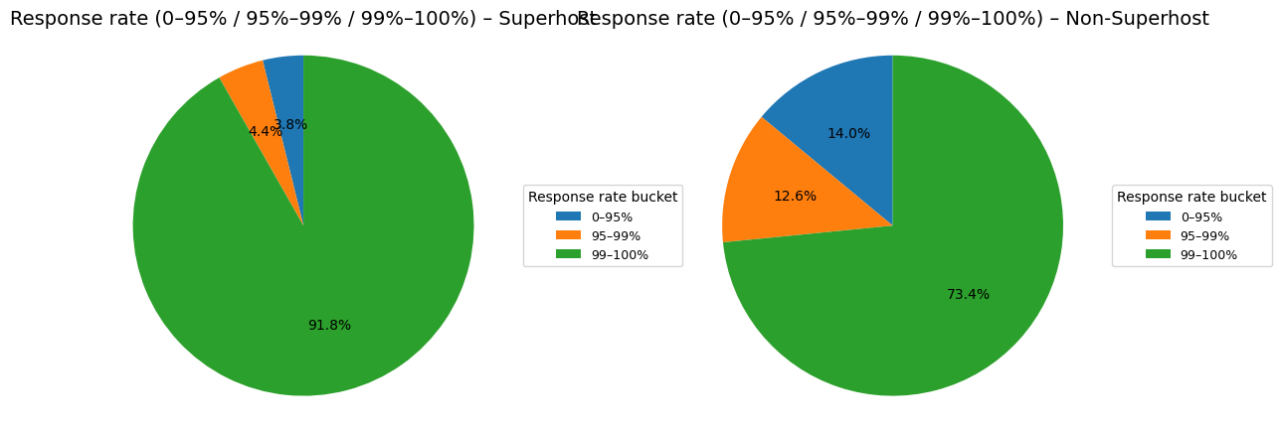
A.1 Operations: Response rate (strong threshold effect)
99–100% response rate: Superhost 91.8% vs Non-Superhost 73.4%
Superhosts are highly concentrated in the 99–100% bucket (~91.8%).
Non-Superhosts have a much higher share below 95% (~14%).
Interpretation: high response rate is an entry ticket to be a superhost; 100% appears in both groups →
a threshold, not sufficient alone.
Internal analysis (NZ Airbnb usecase)
Notes:
[Sources]
- Internal notebook: NZ_Airbnb usecase Analysis 10.0.ipynb
- Visual: Chart from notebook output (cell 023)
[/Sources]

Slide 7
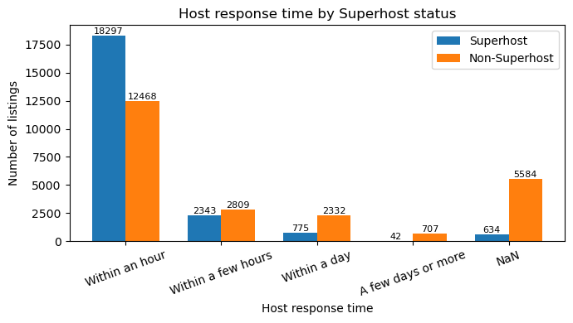
A.1 Operations: Response time (speed gap + missingness gap)
Within an hour: Superhost 18,297 vs Non-Superhost 12,468; Non-Superhost has far more Unknown/NaN
Superhost almostly response Within an hour.
Non-Superhosts response time show higher counts in “Within a day / A few days or more”.
Non-Superhosts also have much more NaN/Unknown, typically indicating incomplete information or unstable response processes.
Internal analysis (NZ Airbnb usecase)
Notes:
[Sources]
- Internal notebook: NZ_Airbnb usecase Analysis 10.0.ipynb
- Visual: Chart from notebook output (cell 026)
[/Sources]

Slide 8
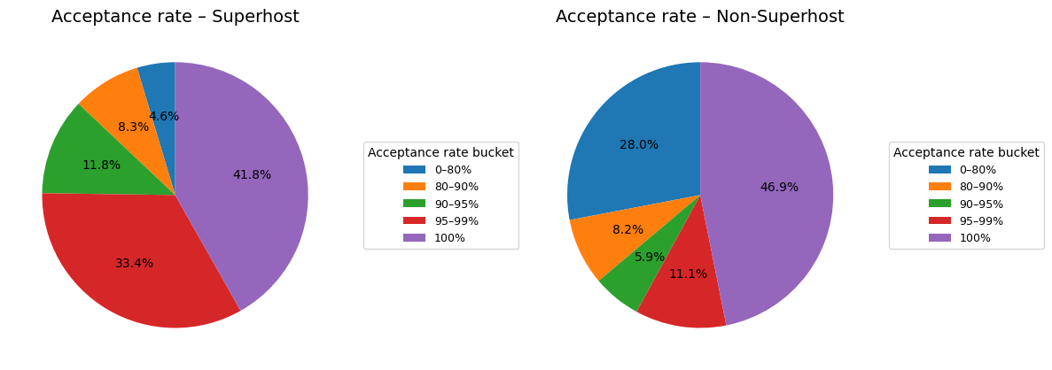
A.1 Operations: Acceptance rate (low buckets dominated by Non-Superhosts)
0–80% bucket: Superhost 4.6% vs Non-Superhost 28.0%
Non-Superhosts are heavily represented in low acceptance (0–80%, ~28%).
Superhosts concentrate in high acceptance rate around 33.4%+41.8% (95–99% and 100%).
Interpretation: Acceptance rate indicates host's willingness to make a purchase, which affects conversion rate and guest experience.
Internal analysis (NZ Airbnb usecase)
Notes:
[Sources]
- Internal notebook: NZ_Airbnb usecase Analysis 10.0.ipynb
- Visual: Chart from notebook output (cell 031)
[/Sources]

Slide 9
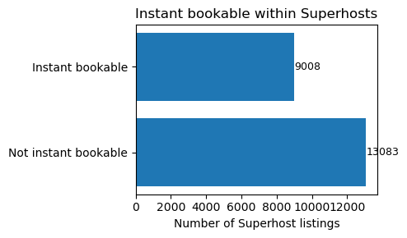
A.1 Operations: Instant Book (helpful, but not decisive)
Within Superhosts: Instant Book 9,008 vs Not instant 13,083
Most Superhosts do NOT require Instant Book (the majority have it off).
The primary differentiators remain consistently high response rate, fast response time, and high acceptance rate.
Internal analysis (NZ Airbnb usecase)
Notes:
[Sources]
- Internal notebook: NZ_Airbnb usecase Analysis 10.0.ipynb
- Visual: Chart from notebook output (cell 035)
[/Sources]

Slide 10
Branch A.2
Reputation & Review Ratings: consistent delivery drives better reputation
Notes:
[Sources]
- Internal notebook: NZ_Airbnb usecase Analysis 10.0.ipynb
[/Sources]

Slide 11
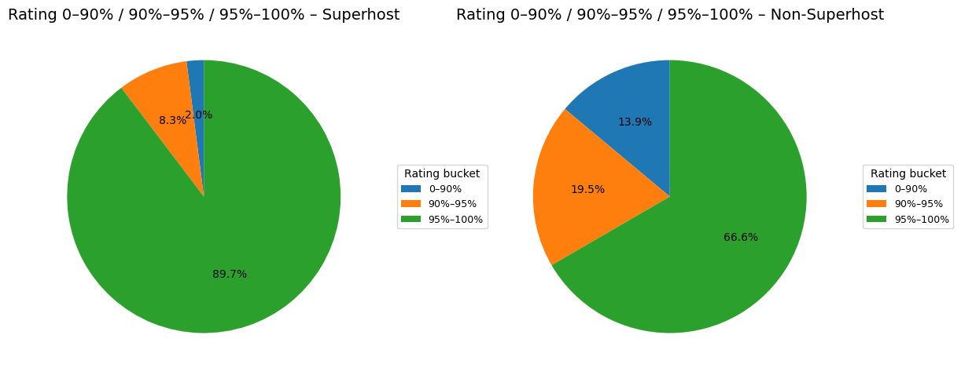
A.2 Reputation: Overall guests experience rating distribution
95–100 bucket: Superhost 89.7% vs Non-Superhost 66.6%; 0–90 bucket: 2.0% vs 13.9%
Superhosts have a much larger share in the high overall experience (95-100) score bucket (89.7%).
Non-Superhosts have a significantly larger low overall experience (0-90) score bucket (13.9%).
Interpretation: Superhosts deliver more consistently;The proportion of low ratings is even lower..
Internal analysis (NZ Airbnb usecase)
Notes:
[Sources]
- Internal notebook: NZ_Airbnb usecase Analysis 10.0.ipynb
- Visual: Chart from notebook output (cell 045)
[/Sources]

Slide 12
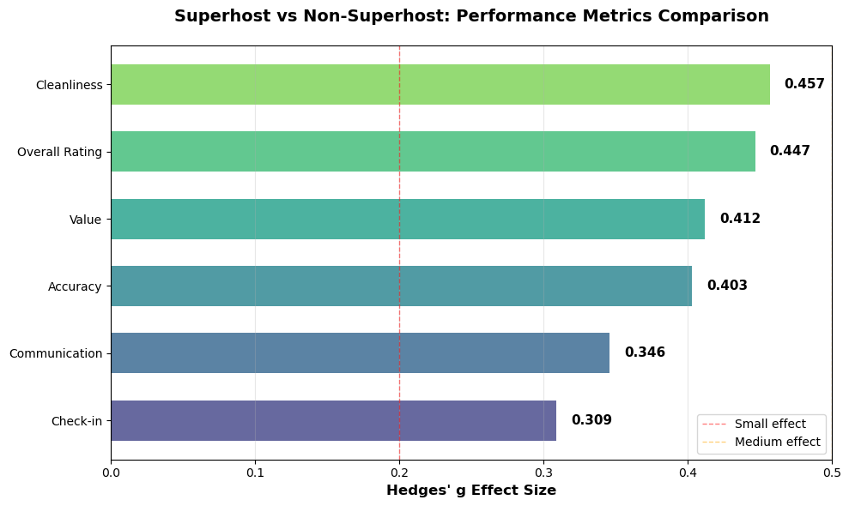
A.2 Reputation: which dimensions differ most? (Hedges’ g effect size)
Cleanliness / Overall / Value / Accuracy show medium effects (~0.40–0.46)
Top gaps: Cleanliness (0.457), Overall (0.447), Value (0.412), Accuracy (0.403).
These features are operational and improvable.
Communication / Check in also lead, but with smaller effect sizes.
Internal analysis (NZ Airbnb usecase)
Notes:
[Sources]
- Internal notebook: NZ_Airbnb usecase Analysis 10.0.ipynb
- Visual: Chart from notebook output (cell 080)
[/Sources]

Slide 13
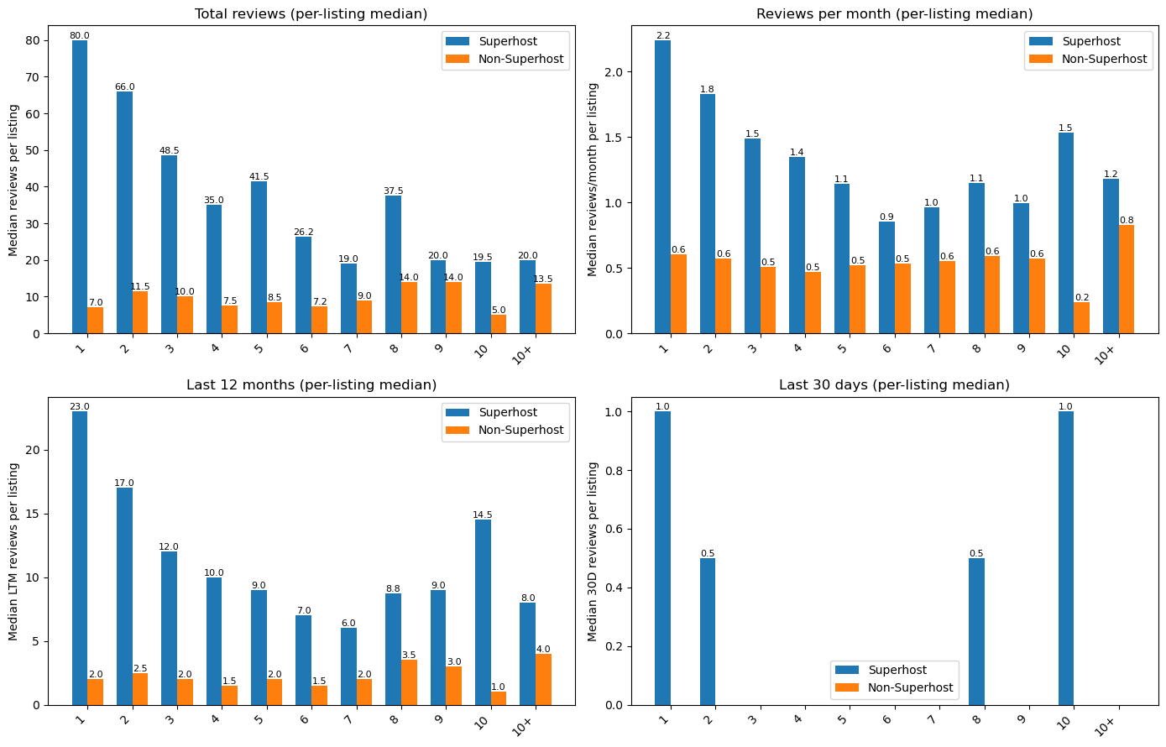
A.2 Reputation momentum: Recently Reviews
Compare “median reviews per listing” by host portfolio size bucket (1…10+)
Single-listing hosts (1 listing): Superhosts show much higher per-listing medians in total reviews, reviews per month, and last-12-months reviews, and are more likely to have reviews in the last 30 days.
Scaling effect: As portfolio size increases, per-listing review momentum declines for both groups, but Non superhost get steeper drop.
Interpretation: Superhosts are not only “better rated”; they also receive more consistent recent feedback, suggesting steadier occupancy and more reliable service delivery.
Internal analysis (NZ Airbnb usecase)
Notes:
[Sources]
- Internal notebook: NZ_Airbnb usecase Analysis 10.0.ipynb
- Visual: notebook output (cell 108)
[/Sources]

Slide 14
Branch A.3
Host experience & trust signals: tenure and information completeness
Notes:
[Sources]
- Internal notebook: NZ_Airbnb usecase Analysis 10.0.ipynb
[/Sources]

Slide 15
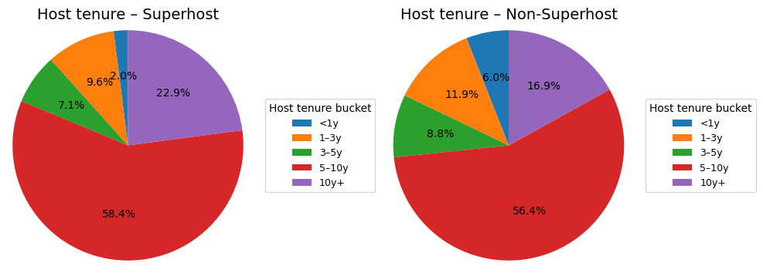
A.3 Host Experience (longer tenure correlates with Superhost share)
10years+: Superhost 22.9% vs Non-Superhost 16.9%; <1year: 2.0% vs 6.0%
Most hosts with over 10 years of experience are superhosts.
Non-superhosts are more common among hosts with less than 1 year of host experience, reflecting that new hosts need time to establish stable operations.
Implication: New hosts should focus on standardized operations and leveraging recent positive reviews to achieve quick results.
Internal analysis (NZ Airbnb usecase)
Notes:
[Sources]
- Internal notebook: NZ_Airbnb usecase Analysis 10.0.ipynb
- Visual: Chart from notebook output (cell 118)
[/Sources]

Slide 16
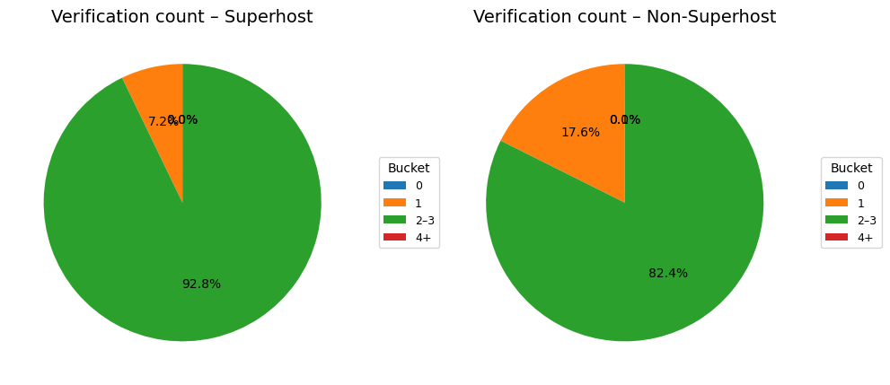
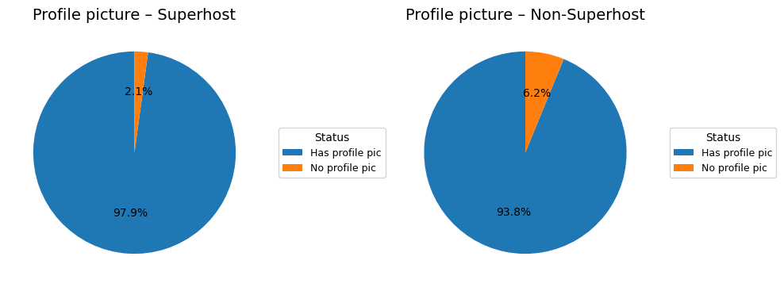
A.3 Trust signals: profile completeness (photo / verification)
Superhosts have fewer “missing info” cases and look more like trusted counterparties
Profile photo: “no photo” is ~2.1% for Superhosts vs ~6.2% for Non-Superhosts.
Verification count: Superhosts cluster at 2–3 verifications (~92.8% vs ~82.4%).
Interpretation: it’s not one specific verification, but the combination of completeness + multiple verifications that increases trust.
Internal analysis (NZ Airbnb usecase)
Notes:
[Sources]
- Internal notebook: NZ_Airbnb usecase Analysis 10.0.ipynb
- Visuals: Notebook outputs (cell 128, 133)
[/Sources]

Slide 17
Branch A.4
Supply structure: price / capacity / amenities / location
Notes:
[Sources]
- Internal notebook: NZ_Airbnb usecase Analysis 10.0.ipynb
[/Sources]

Slide 18
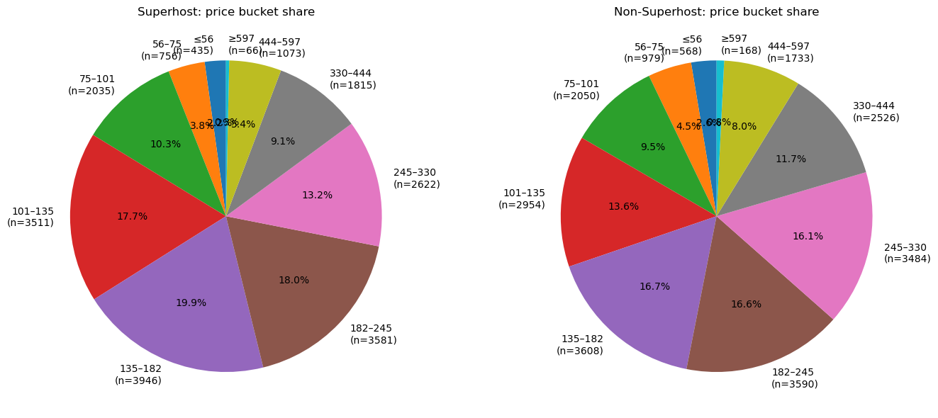
A.4 Pricing: price bucket share (Superhosts concentrate in midtier)
After IQR trimming: Non-Superhosts have higher mean/median price (~+10–13%)
Superhosts mainly cluster in NZD 105–215 and NZD 135–182 mid price ranges.
Non-Superhosts have a higher share in upper price ranges (NZD 444–597, ≥597).
Implication: Superhost is closer to strong value + consistent experience rather than pure price premium.
Internal analysis (NZ Airbnb usecase)
Notes:
[Sources]
- Internal notebook: NZ_Airbnb usecase Analysis 10.0.ipynb
- Visual: Chart from notebook output (cell 143)
[/Sources]

Slide 19
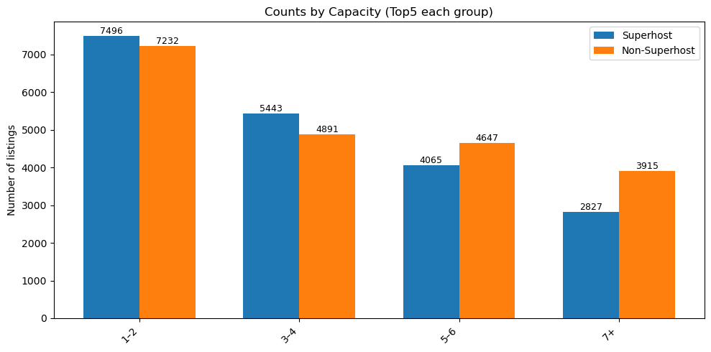
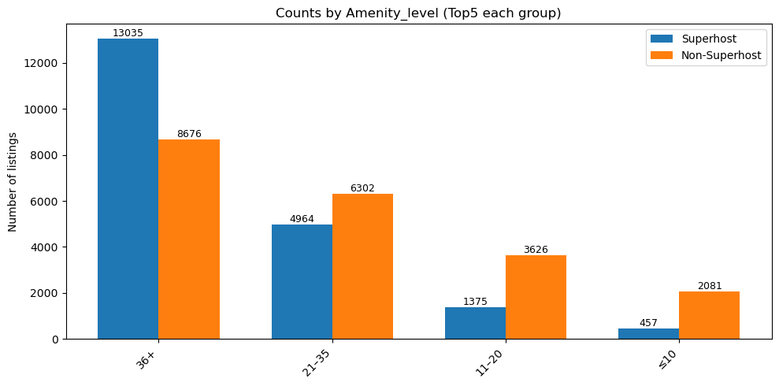
A.4 Capacity & amenities: similar structure, but Superhosts are more fully equipped
Capacity concentrates in 1–4 guests; Superhosts have a higher share of high-amenity listings
Capacity: both groups focus on 1–2 and 3–4 guests; Non-Superhosts have relatively more 7+ capacity listings (larger homes but not necessarily better reviews).
Amenities level: Superhosts are more concentrated in higher amenity buckets.
Implication: amenities alone don’t guarantee Superhost, but the expected basics + no surprises increases the chance of good reviews and repeat stays.
Internal analysis (NZ Airbnb usecase)
Notes:
[Sources]
- Internal notebook: NZ_Airbnb usecase Analysis 10.0.ipynb
- Visuals: Notebook outputs (cell 153, 156)
[/Sources]

Slide 20
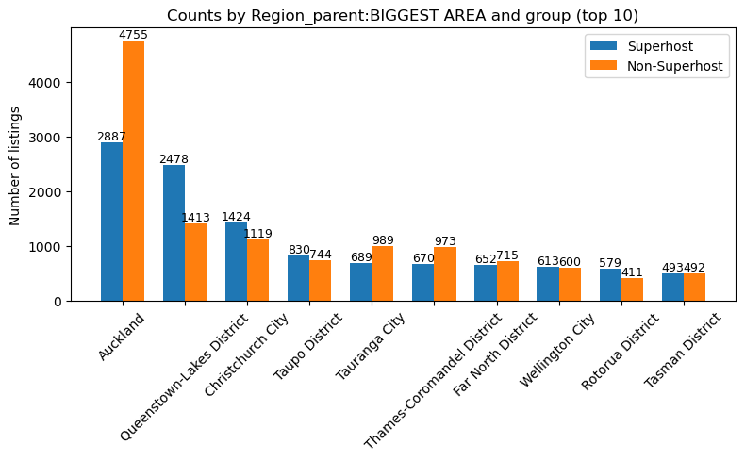
A.4 Location: Region parent (Top 10)
Auckland is the largest market; tourist destinations (e.g., QueenstownLakes) have a higher Superhost share
Auckland: the most competitive battlefield→ both groups concentrate heavily here.
QueenstownLakes and other destination regions appear in Top 10 and superhost show a more pronounced share.
Interpretation: Popular market relies more on the host's experience and reputation, which makes it easier for superhost to accumulate advantages.
Internal analysis (NZ Airbnb usecase)
Notes:
[Sources]
- Internal notebook: NZ_Airbnb usecase Analysis 10.0.ipynb
- Visual: Chart from notebook output (cell 160)
[/Sources]

Slide 21
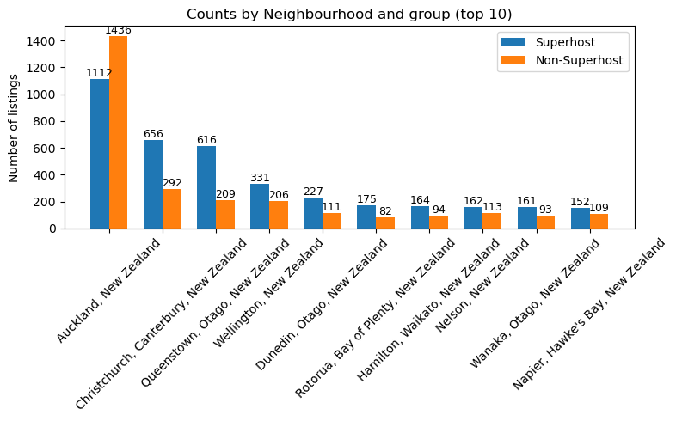
A.4 Location: Neighbourhood (Top 10)
Supply concentrates in core city clusters (Auckland / Christchurch / Queenstown / Wellington)
Core city clusters dominate overall supply.
Within the same cluster, Superhost vs Non-Superhost distributions are similar → differences are more driven by operations than by location choice alone.
Internal analysis (NZ Airbnb usecase)
Notes:
[Sources]
- Internal notebook: NZ_Airbnb usecase Analysis 10.0.ipynb
- Visual: Chart from notebook output (cell 166)
[/Sources]

Slide 22
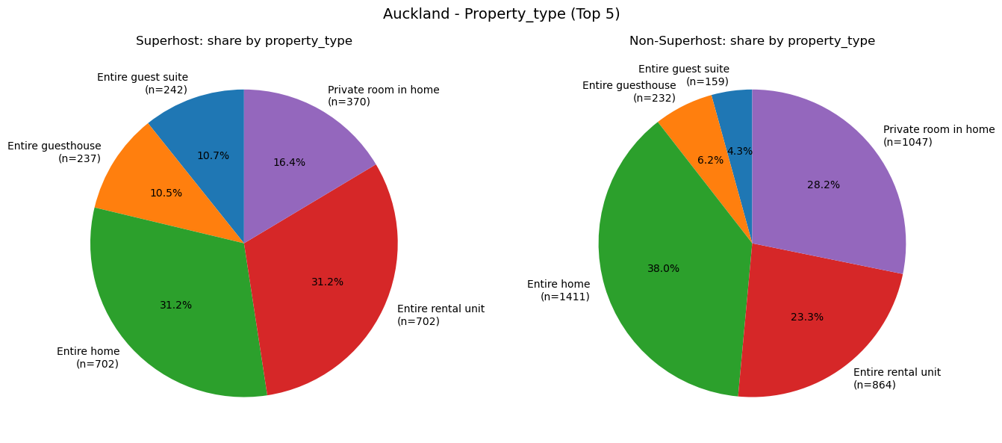
City deep dive: Auckland (property type structure)
Within one city: structure is similar, but Superhosts outperform on amenities/reputation/momentum
Auckland is dominated by Entire home / Entire rental unit demands; Non-Superhosts have a higher share of Private rooms.
Even under similar structures, Superhosts build advantage through consistent delivery + recent reviews.
Internal analysis (NZ Airbnb usecase)
Notes:
[Sources]
- Internal notebook: NZ_Airbnb usecase Analysis 10.0.ipynb
- Visual: Chart from notebook output (cell 185)
[/Sources]

Slide 23
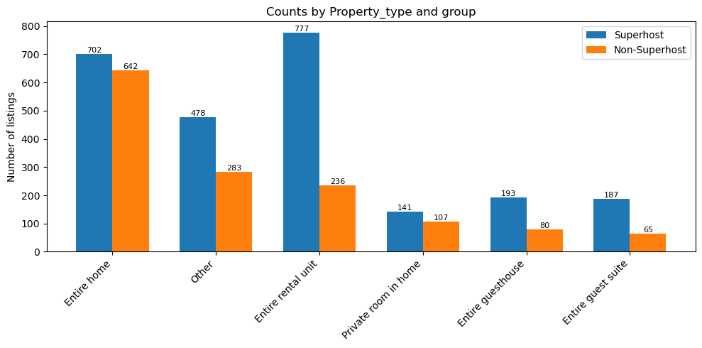
City deep dive: Queenstown (property type structure)
Destination market: higher share of Entire rental unit / Entire home; operational gaps are amplified
QueenstownLakes related areas are prominent in Top 10 supply.
Superhosts have larger scale in entire place categories, typically aligned with more stable occupancy in a destination market.
Internal analysis (NZ Airbnb usecase)
Notes:
[Sources]
- Internal notebook: NZ_Airbnb usecase Analysis 10.0.ipynb
- Visual: Chart from notebook output (cell 190)
[/Sources]

Slide 24
Branch A recap: drivers ranked by impact (strong → weak)
Prioritize actionable levers first
1) Reputation quality: Cleanliness / Overall / Value / Accuracy (largest and most operable gaps).
2) Operations thresholds: response rate, response time, acceptance rate (near-perfect is baseline).
3) Review momentum: recent reviews (30D/LTM) as a demand/occupancy proxy.
4) Trust signals: profile photo + verification + information completeness.
5) Supply structure: room type/capacity/location differ less; performance differs within similar structures.
Practical playbook for new hosts
Standardize cleaning and handover SOPs (reduce the low-score tail).
Keep descriptions accurate (avoid expectation gaps).
Make response & acceptance “default 99–100%” via routines/templates.
Optimize for recent reviews: pricing/promotions, and minimize cancellation & bad review risks.
Internal analysis (NZ Airbnb usecase)
Notes:
[Sources]
- Internal notebook: NZ_Airbnb usecase Analysis 10.0.ipynb (Branch A Final Conclusion)
[/Sources]

Slide 25
Branch B
Market ↔ Features: how the market evolved and whether structure changed
Notes:
[Sources]
- Internal notebook: NZ_Airbnb usecase Analysis 10.0.ipynb
[/Sources]

Slide 26
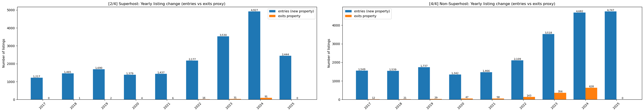
B.1 Market expansion: Entries vs exits (Superhost vs Non Superhost)
2017–2025 supply keeps expanding; growth accelerates in 2023–2024. 2025 is partial-year (to 09.23).
Both groups surge in 2023–2024:
Superhost entries 2,177→3,530→4,927;
Non Superhost 2,109→3,518→4,682.
Exit proxy is concentrated in Non Superhosts (2024 exits: 628 vs 91 for Superhosts).
Note: exits use a 12 month no review rule; 2025 exits are under detected → interpret cautiously.
Internal analysis (NZ Airbnb usecase)
Notes:
[Sources]
- Internal notebook: NZ_Airbnb usecase Analysis 10.0.ipynb
- Visual: Chart from notebook output (cell 229)
[/Sources]

Slide 27
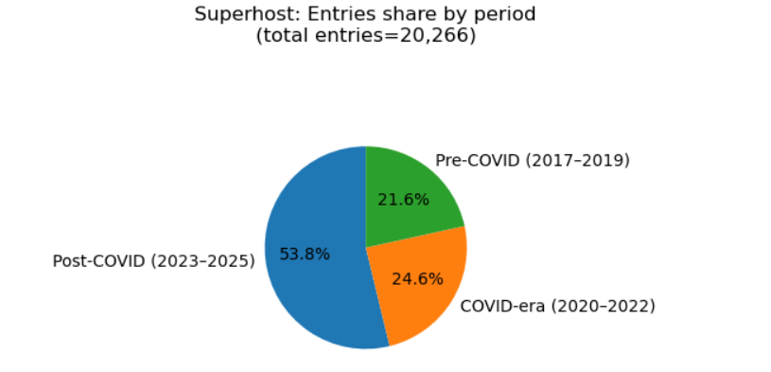
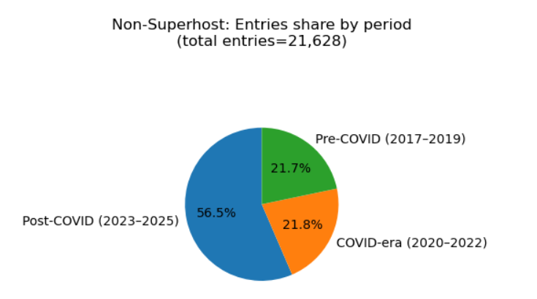
B.1 Entry structure: Pre COVID / COVID era / Post COVID (Entry share)
Cohorts: Pre COVID (2017–2019) · COVID era (2020–2022) · Post COVID (2023–2025).
Entries are dominated by Post COVID for both groups: Superhost 53.8% vs Non Superhost 56.5%.
Superhosts have a slightly higher Pre COVID share (21.6%) than Non Superhosts (21.7%), reflecting accumulated experience.
Implication: growth is broad-based, but experience/reputation still makes it easier for Superhosts to sustain advantage.
Internal analysis (NZ Airbnb usecase)
Notes:
[Sources]
- Internal notebook: NZ_Airbnb usecase Analysis 10.0.ipynb
- Visual: Chart from notebook output (cell 215)
[/Sources]

Slide 28
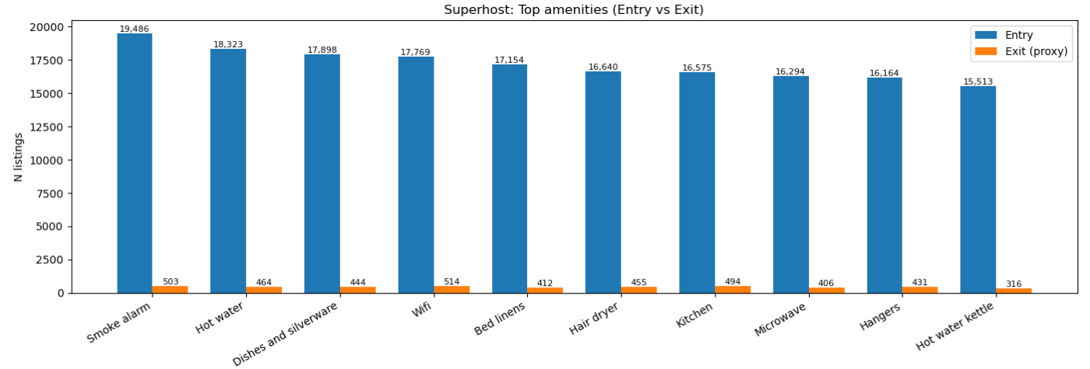
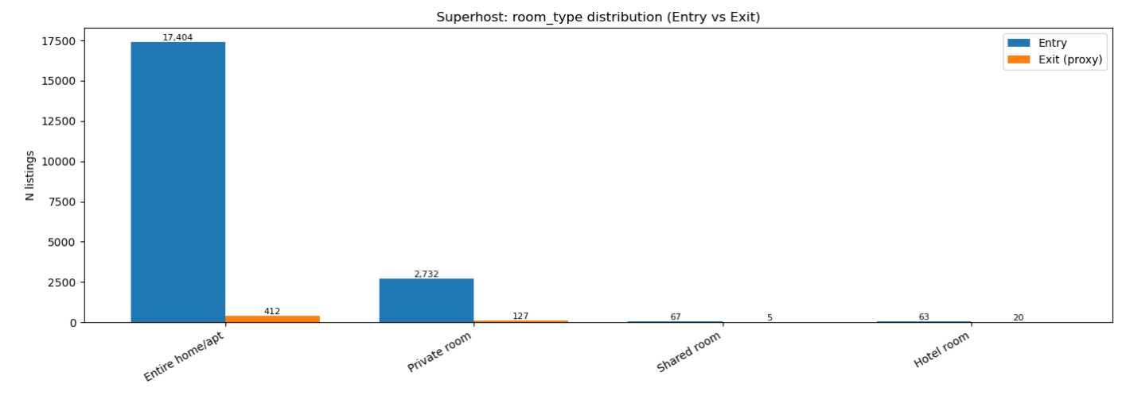
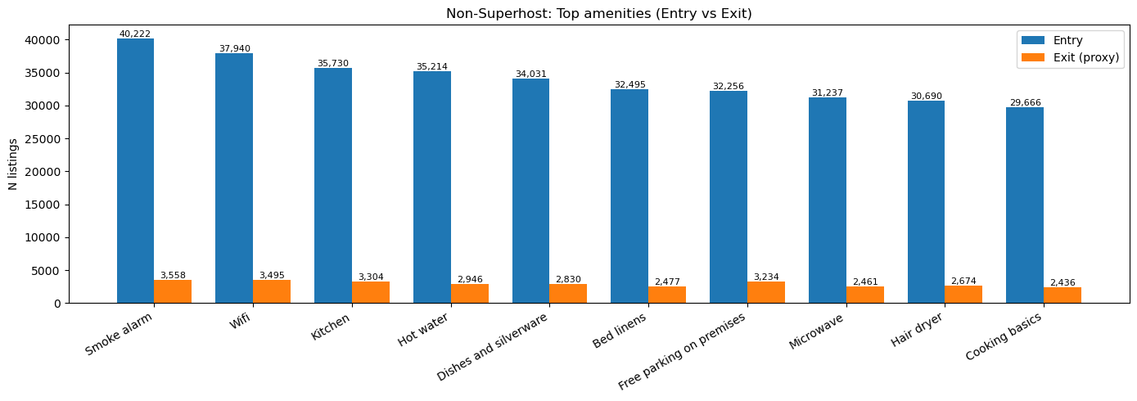
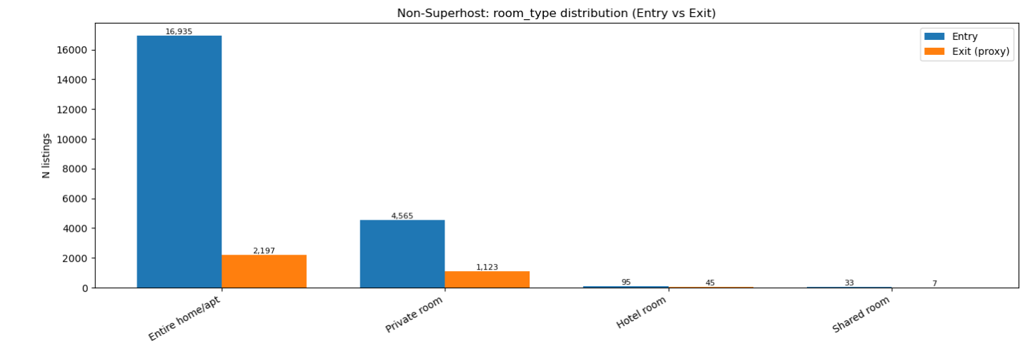
B.1 Entry/exit structure: Room type & amenities (Superhost vs Non Superhost)
Structure is broadly stable: entries concentrate in the same configurations that dominate the market.
Room type:The highest demand in the market are still Entire home/apts; non-superhosts are showing a clear exit trend across all property types.
Amenities: Essentials (smoke alarm/Wi Fi/kitchen, etc.) are market basics; Non Superhosts exit more within the same basics set.
Takeaway: supply structure is similar; operational stability differentiates outcomes.
Internal analysis (NZ Airbnb usecase)
Notes:
[Sources]
- Internal notebook: NZ_Airbnb usecase Analysis 10.0.ipynb
- Visuals: Notebook outputs (cell 218, 219)
[/Sources]

Slide 29
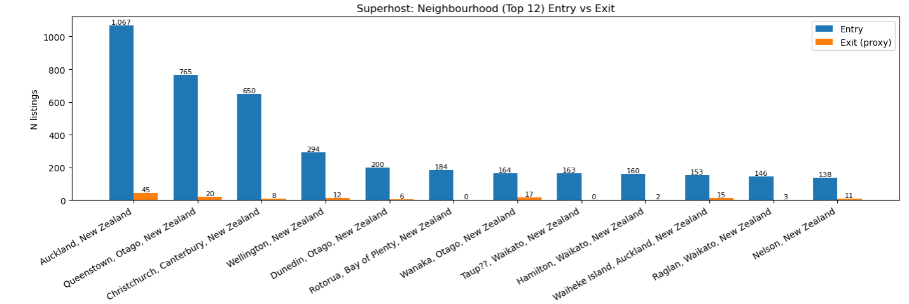
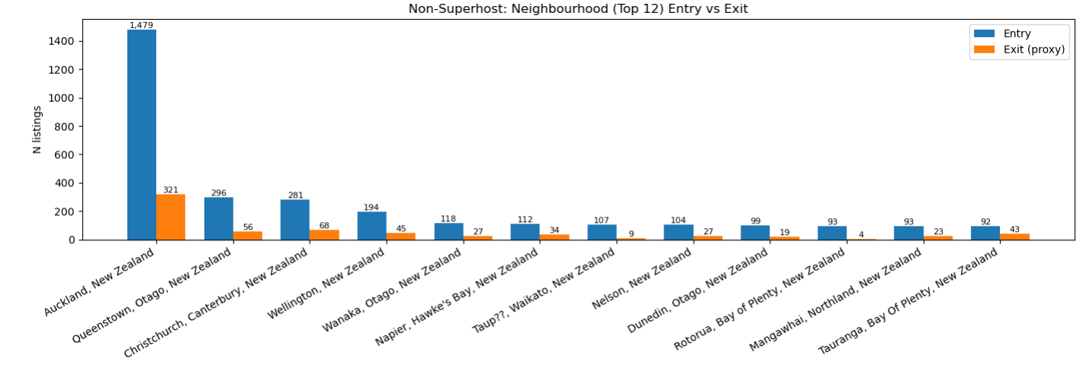
B.1 Spatial pattern: Entry vs exit (Top neighbourhoods, Superhost vs Non Superhost)
Both entry and exit cluster in core cities and tourist hubs (Auckland / Queenstown / Christchurch / Wellington).
• Non Superhosts show heavier exit counts across the same hotspots, indicating higher churn among newer/less-experienced hosts.
• Growth follows demand, but retention is a capability problem (operations + reputation).
Auckland/Queenstown/Christchurch/ Wellington remain the center of supply change.
Exits concentrate in the same regions → location alone does not explain churn; operations and demand fit matter more.
Internal analysis (NZ Airbnb usecase)
Notes:
[Sources]
- Internal notebook: NZ_Airbnb usecase Analysis 10.0.ipynb
- Visual: Chart from notebook output (cell 222)
[/Sources]

Slide 30
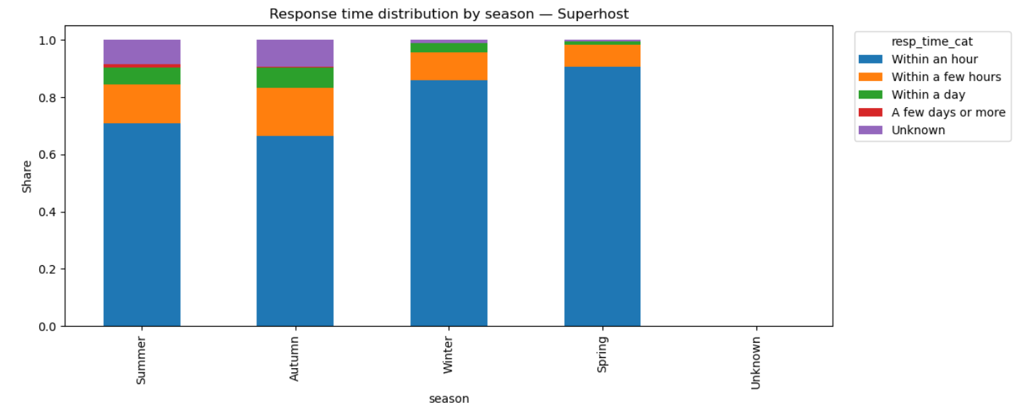
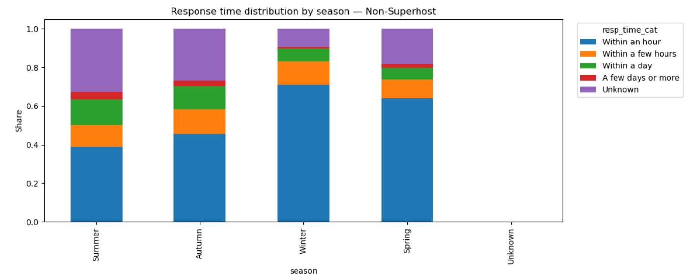
B.2 Seasonality: Response time by season (Superhost vs Non Superhost)
Fast response is consistently more common for Superhosts; Non Superhosts have a larger slow/unknown share.
Superhosts maintain a higher share of “within an hour / within a few hours” across seasons.
Non Superhosts show more “Unknown” / slower responses, especially in peak seasons when demand spikes.
Operational discipline (response SLAs) is a persistent differentiator.
Internal analysis (NZ Airbnb usecase)
Notes:
[Sources]
- Internal notebook: NZ_Airbnb usecase Analysis 10.0.ipynb
- Visual: Chart from notebook output (cell 238)
[/Sources]

Slide 31
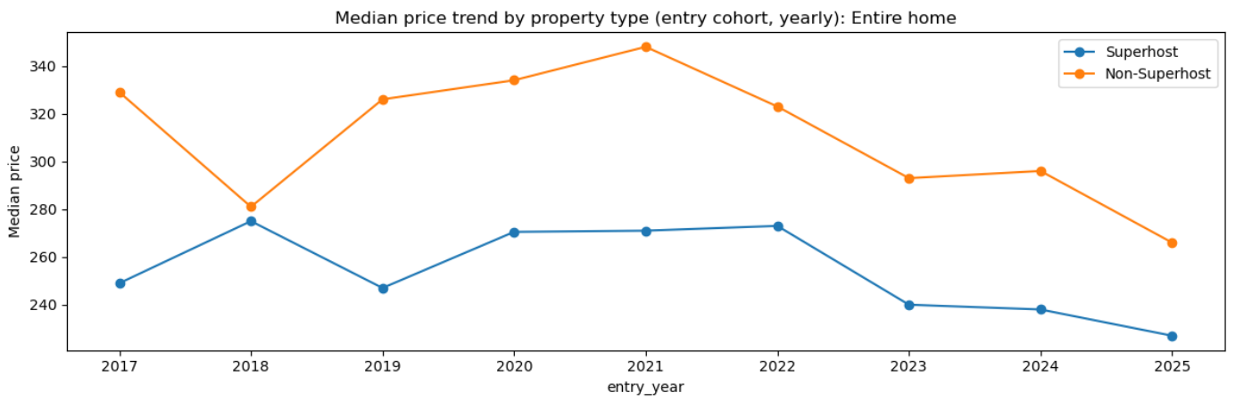
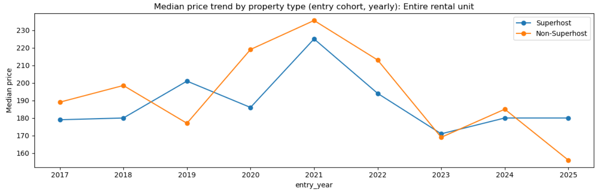
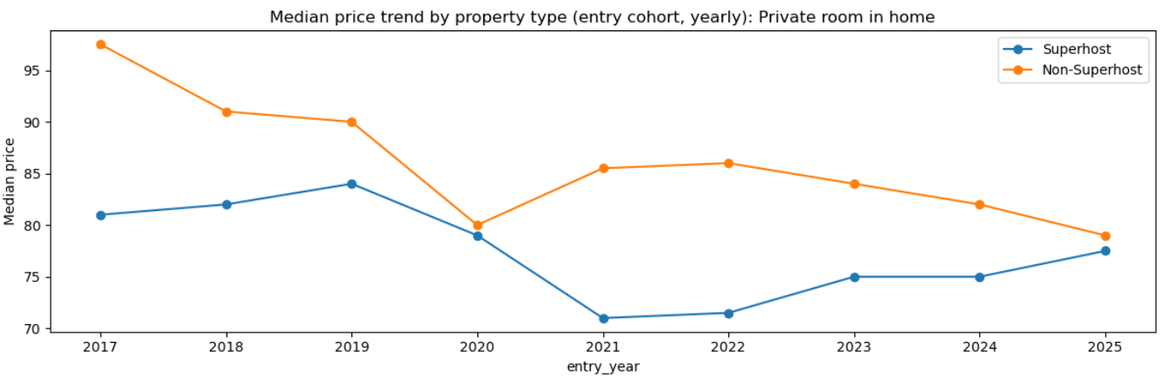
B.3 Pricing trend: Entry cohorts by property type (median price)
Examples: Entire home · Entire rental unit · Private room in home (Superhost vs Non Superhost).
Price level is primarily driven by property type;
Superhost vs Non Superhost gaps are smaller than cross type differences.
Post COVID cohorts show more volatility; treat 2025 as partial-year.
Implication: structure sets the level; execution (reviews/response) sets the advantage.
Internal analysis (NZ Airbnb usecase)
Notes:
[Sources]
- Internal notebook: NZ_Airbnb usecase Analysis 10.0.ipynb
- Visual: Chart from notebook output (cell 248)
[/Sources]

Slide 32
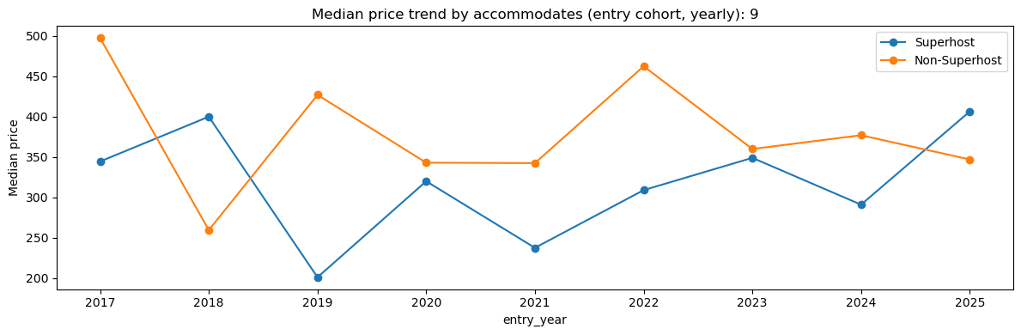
B.3 Pricing trend: Entry cohorts by accommodates (median price)
Example cohort: accommodates = 9 (Superhost vs Non‑Superhost).
Larger-capacity listings with higher prices but also the greater the price difference between different properties.
Price differences between properties vary from year to year; market conditions determine price levels, while operational performance determines price stability.
Internal analysis (NZ Airbnb usecase)
Notes:
[Sources]
- Internal notebook: NZ_Airbnb usecase Analysis 10.0.ipynb
- Visual: Chart from notebook output (cell 249)
[/Sources]

Slide 33
Branch B recap: expanding market, stable structure, widening operational divergence
Turn findings into strategy
1) New listings will continue to expand from 2017 to 2025, with accelerated growth in 2023-2024 (2025 is for some years).
2) Asymmetric host attrition: The exit rate of non-Superhosts is relatively high, especially after the COVID-19 pandemic.
3) Long-term market demand structure remains stable: Entire properties are preferred, followed by single rooms; market differences mainly stem from performance within the same property structure.
4) Within the same market segment: Superhosts have lower year-round availability but higher recent ratings; prices are not necessarily higher.
Implications for business / operations
The market is “professionalizing”: stable hosts stay and scale; unstable hosts exit.
Recommended that new hosts improve their response speed, enhance their reputation, and complete their platform information description.
Internal analysis (NZ Airbnb usecase)
Notes:
[Sources]
- Internal notebook: NZ_Airbnb usecase Analysis 10.0.ipynb (Branch B Final Conclusion)
[/Sources]

Slide 34
Action Plan (ready to execute)
Turn “becoming a Superhost” into a practical 30/60/90 days plan
0–30 days (basic):
Response rate/ acceptance rate: Aim for 99–100%
Response time: Target response within 1 hour (using reply templates/quick replies/automatic messages)
Platform information must be complete: Avatar, identity verification, property description, and check-in rules clearly stated in one go.
30–90 days (Long-term plan):
Improve property cleanliness and enhance the overall guests check in experience.
ImproveNZ Airbnb profile accuracy and value for money.
Gain more recent reviews: Drive orders with reasonable pricing and small promotions; reduce cancellations and lower the risk of negative reviews.
Prepare in advance for peak season: Plan ahead for manpower, message response, and check-in arrangements to avoid slow response times.
Suggested North Star metrics (platform/ops)
• Recent reviews per listing (30D and LTM) as demand momentum
• Experience consistency: share of low score tail for Cleanliness/Accuracy/Value
• Threshold compliance: share with <95% response or <90% acceptance (lower is better)
Internal analysis (NZ Airbnb usecase)
Notes:
[Sources]
- Internal notebook: NZ_Airbnb usecase Analysis 10.0.ipynb (Branch A Final Conclusion; review/response analyses)
[/Sources]

Slide 35
Machine Learning Validation (Blocks A–D)
Block | AUC | PR-AUC | Accuracy | F1 | Interpretation
C_activity | 0.8122 | 0.7851 | 0.7408 | 0.6949 | Strongest signal: recent review momentum & recency
D_listing (HGB) | 0.7160 | 0.6849 | 0.6578 | 0.6415 | Medium: location + price + property structure
A_response | 0.6201 | 0.5414 | 0.5812 | 0.6450 | Base:acceptance/ response quality matters
B_score ratings | 0.5921 | 0.5116 | 0.5536 | 0.5873 | Weakest: ratings have ceiling effect; still actionable
Key message: Superhost status is best explained by sustained review momentum (last 12 months / recent reviews),then structural factors (location + pricing + room/property type).
Operational response/acceptance is a necessary baseline, while ratings are actionable levers (especially cleanliness) but less predictive alone.

Slide 36
Final Leadership Takeaways & Priorities
Priority 1 — Review Momentum (largest impact):
  Drive steady recent reviews (30D) and strong 12 month review volume (LTM); reduce 'days since last review'.
  This is the strongest differentiator between Superhost vs Non‑Superhost.
Priority 2 — Location & Pricing (structural strategy):
  Within each region/segment, optimize value for money and pricing; avoid high price / low review traps.
Priority 3 — Operational Thresholds (entry ticket):
  Maintain near perfect response rate, fast response time, and high acceptance rate using templates/SOPs.
Priority 4 — Reputation Improvements (most actionable rating lever):
  Focus on Cleanliness + Accuracy + Value alignment to reduce the low score tail and protect momentum.
Recommended North Star metrics for ops:
  Recent reviews per listing (30D & LTM), share below threshold (<95% response; <90% acceptance), and low‑score tail share for cleanliness/accuracy/value.

